Slide 1









Mayank Kumar

Slide 2


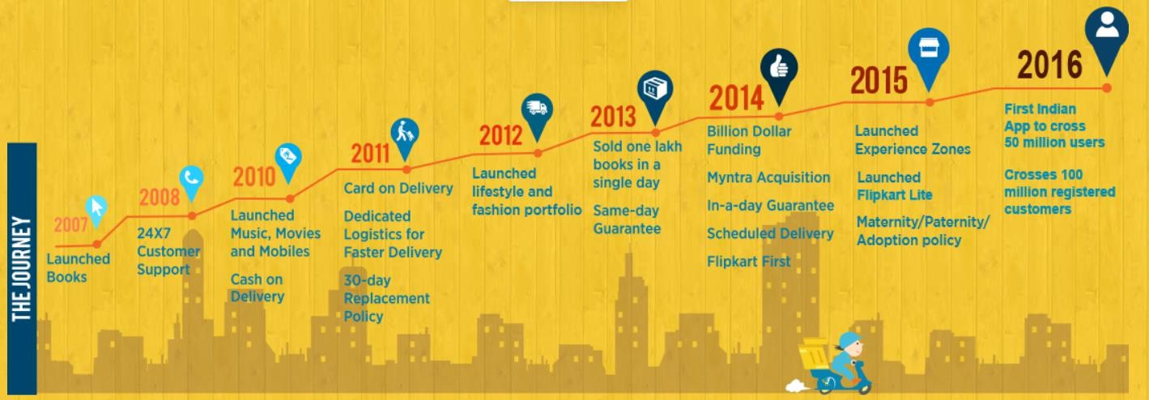
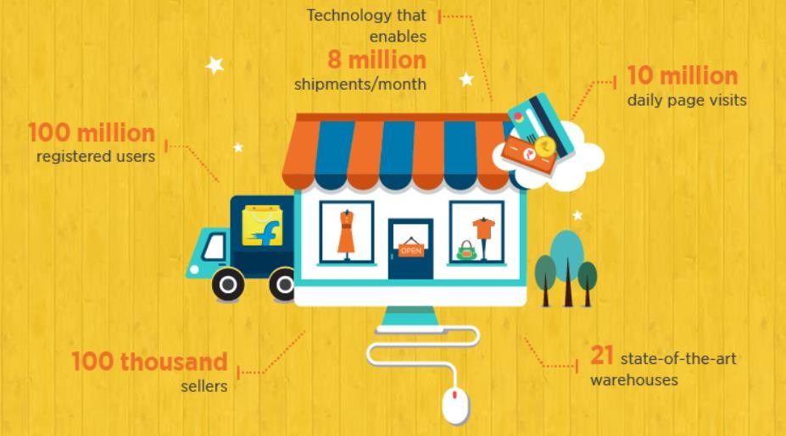




Flipkart is an Indian e-commerce company, founded back in 2007 by Sachin & Binny Bansal. Incorporated in Singapore and headquartered in Bangalore, the company started with online book sales, later entering other product categories such as consumer electronics, fashion, home essentials, groceries, and lifestyle products. Currently it has over 80 million products across 80+ categories.
The total revenue in 2022 was that of Rs 43,357 crore was reported for the past fiscal year of 2020-2021; 25% more than its revenue in the fiscal year of 2020
As of March 2017, Flipkart held a 39.5% market share of India's e-commerce industry which increased to 60% (For flipkart group in 2021 festive sales).
Competitors:
Value Propositions:
Accessibility
Convenience
Price
Risk reduction
Brand/Status
Mission Statement:
“Ab har wish hogi poori!”
Vision:
To be largest E-commerce marketplace in India

Slide 3

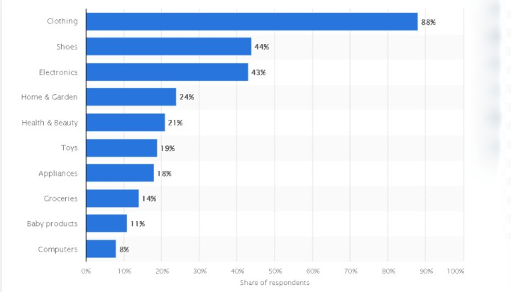
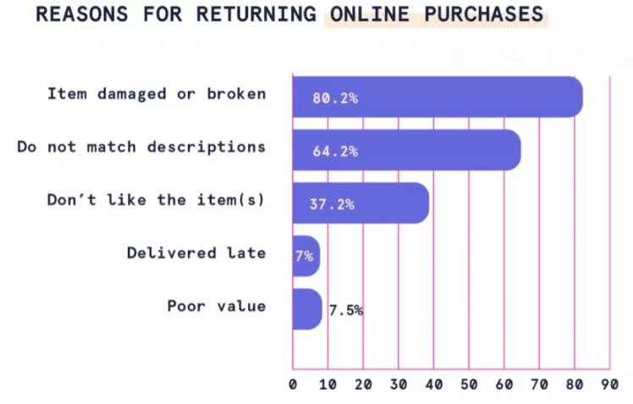
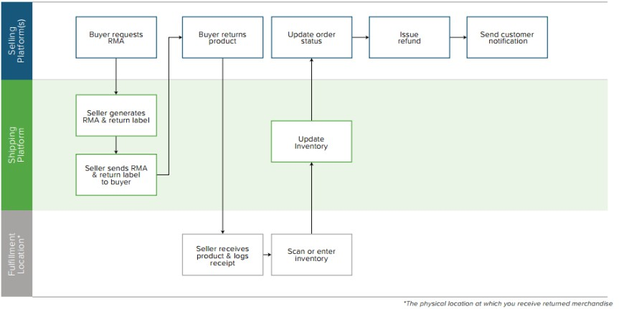
Return Overview:
According to these data points, the most returned product type is clothing with a leading 88%.
The most popular reason to return is that item is damaged or broken. However, it also includes instances where customer used the product within the return period and later claimed it to be broken/damaged.
Source: swifterm.com
Source: makewebbetter.com
This is the flow product goes through in case of an average return process. The cost of return or refund is beared by sellers in terms of packaging, forward, and reverse
logistics
Source: shippingeasy.com
(Scan & assess quality of returned product)
User Action Flow before opening app for return:
Compares it to variant ordered, pictures in App
Checks if product
window allows
refund/return
Opens the ‘Order’ tab to put up request
Collects Order
Checks Items
Collects Order
Finds Fault / Mismatch

Slide 4























Slide 5


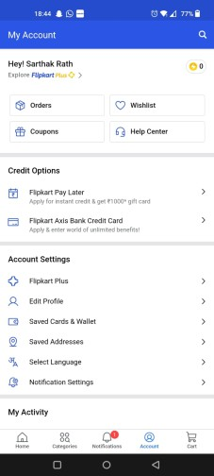
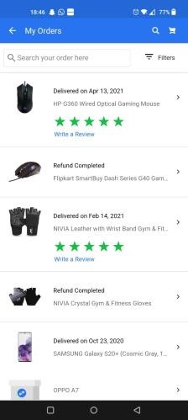
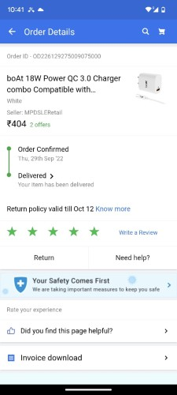
Opens Order
page
Account tab
Opens Order
Doing
I ordered boat charger. Instead I got a second copy charger. I hope they give me a refund.
I hope the return date hasn’t gone by and there are no other hidden T&C to this.
This was the order. Good! I still have time to return this.
I finally found the return button.
Thinking
Feeling
😟
😥
😐
For a new user, he wont be able to navigate easily to return button.
Main search bar should also be
able to search common settings
Pain Points & Solutions

Slide 6


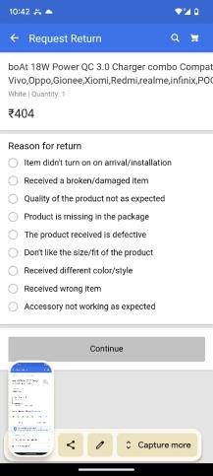
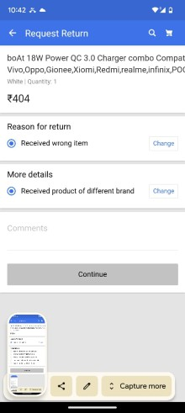
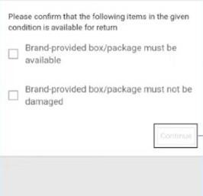
Doing | Return Page | Fill Reasons | T&C
Thinking | There sure are a lot of questions. I hope this process doesn’t take too much time. | I entered my reasons. I hope they qualify for a return. | Good that I still have the packing, but they are asking about the damage. I had to open the packing of course, does that count?
Feeling | 😥 | 🤔 | 🤔
Pain Points & Solutions | In case of reason not found, there should be an option to mention that. |  | Ambiguity Should state more clearly ‘Apart from the expected damage due to opening’ or ‘enough to carry the package safely back’

Slide 7
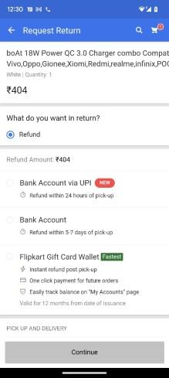
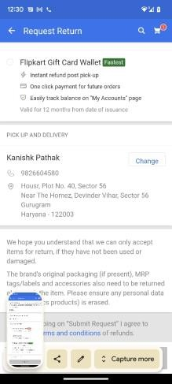
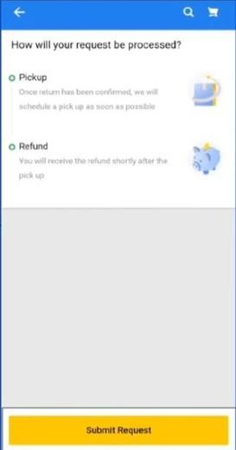
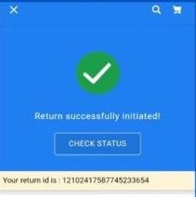
Doing | Refund Method | Confirm Address | Done!
Thinking | I want a refund of the amount. It’s exactly what I wanted. Yay! | Sounds good. Looks like the process is finally finishing up? | Yay! Finally done! Glad I was able to get it done.
Feeling | 😁 | ☺️ | 🥳
Pain Points & Solutions | Inconvenience – have to enter bank details or compromise on account choice. Inclusion of option “Refund to account used for purchase”

Slide 8

The Pros
Easy to navigate after finding the return button.
T&C and the steps of return clearly stated avoiding confusion.
Gift cards reduce overall churn rate.
A comprehensive list of reasons of return, which varies depending on product and amount.
Overall UI is aesthetic and easy to understand.
The Cons
There is no way to indicate if reason not found in given options.
Customer might be irritated while filing
return, should not be prompted to type as
it takes more effort.
The return button not intuitive for new users.
No option to transfer to original account
used for purchase.
Ambiguity in product description & while
specifying how much damage is acceptable to package.

Slide 9

North Star Metric: # Net completed orders per day.
For returns feature:
Customer Return Rate: # Units returned / Total # units delivered successfully.
Customer Exchange Rate: # Units exchanged / Total # units delivered successfully.
Return Cancellation Rate: % Return cancellations.
% Successful Returns.
#Orders returned after one day / #Total orders returned.
#Orders returned after one week / #Total orders returned.
Total time taken to fulfil Returns
Reason split of returns category wise
NPS of Returns.

